Slide 1




MUSIC ANALYSIS
Chin o ok
BY
DEVIKA NITHIAN N H
30 SEP 24

Slide 2
ABOUT
Chinook is a comprehensive digital media store, specializing in the sale of music records across various genres. The company offers a rich and diverse catalog, including everything from rock and jazz to classical and electronic music.
Chinook serves a global customer base, providing both digital downloads and physical music formats such as CDs and vinyl records.
The company’s catalog spans decades of musical evolution, making it a destination for music lovers seeking everything from timeless classics to the latest chart-toppers.

Slide 3

PROBLEM STATEMENT
As a data analyst at Chinook, objective is to analyze music record sales data to identify patterns in customer purchasing behavior, geographic sales trends, and genre preferences, providing insights to optimize the company's strategy in the physical music market.

Slide 4
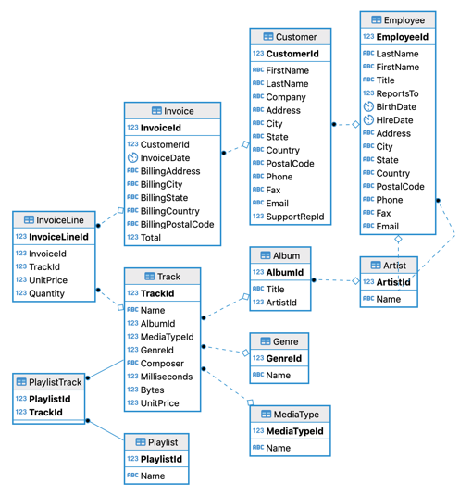
DATABASE SCHEMA

Slide 5
DATA SNAPSHOT
Total Datasets:7 tables from the Chinook database used for analysis:
Customer, Invoice, InvoiceLine, Track, Album, Artist, Genre.
Customer Data: Contains 59 unique customers.
Key columns: customer_id, first_name, last_name, country, state, city, email.
Sales Data (Invoices):Total of 412 invoices.
Key columns: invoice_id, customer_id, invoice_date, total, billing_country.
Track Data:3503 tracks across various genres and albums.
Key columns: track_id, name, album_id, genre_id, composer, milliseconds, unit_price.
Genre Data:25 unique genres (e.g., Rock, Jazz, Classical, Metal).
Key columns: genre_id, name.
Album and Artist Data:347 albums and 275 artists.
Key columns (Album): album_id, title, artist_id.
Key columns (Artist): artist_id, name.

Slide 6

DATA CLEANING AND PREPROCESSING
Handling Missing Data: Identify and handle missing values in key columns (e.g., customer details, purchase amounts, track information) using methods like imputation or removal, ensuring the dataset remains complete and reliable for analysis.
Removing Duplicates: Check for and remove duplicate entries (e.g., duplicate invoices or customer records) to prevent skewed analysis and ensure the dataset accurately reflects unique transactions and customers.
Data Type Correction: Ensure all columns have the correct data types (e.g., dates, numbers, text). Convert data types as necessary to enable accurate analysis, such as converting string representations of dates into DATE types.

Slide 7

ANALYTICAL APPROACH AND TOOLS
Data Collection and Exploration: Use SQL to extract and explore sales data from Chinook’s relational database, including customer demographics, invoices, tracks, albums, artists, and genres.
Descriptive Analysis: Perform basic statistical analysis to summarize key metrics such as total sales, customer segments, genre preferences, and geographic trends.

Slide 8
ANALYTICAL APPROACH AND TOOLS
Customer Segmentation: Segment customers based on their spending behavior, purchase frequency, and location using SQL queries.
Geographical Analysis: Analyze sales performance by country, state, and city, helping to identify regions with high growth potential and emerging markets for strategic expansion.

Slide 9
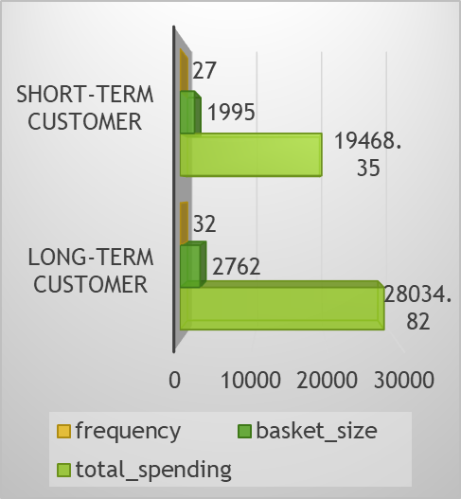
OBJECTIVE QUESTION ANALYSIS
Customer Segmentation & Top Performers
Customer Demographics:-
Limited data (59 customers) suggests an older customer base (51-77 years old).
Significant variance in purchase activity (0-214 purchases).
Top Customers by Revenue (Each Country):-
Brazil dominates, indicating a strong customer base for potential growth.
Diverse spending patterns across countries suggest regional variations.
High-spending customers present valuable opportunities (e.g., Helena Holy).

Slide 10
Purchase Frequency & Order Value:
No direct correlation between purchase frequency and average order value.
Customers from some countries (Brazil, Canada, Czech Republic) have higher average order values.
Customer Churn Rate:
The churn rate of 40.74% indicates that nearly 41% of the customers who were active in the first quarter of 2020 stopped engaging with the business by the end of the year. This could highlight potential areas of concern, such as customer satisfaction, competition, or changing market dynamics that need to be addressed.
Customers with Diverse Genres (>= 3):
Represent potential for higher Customer Lifetime Value (CLV) due to broader interest.
Cross-selling opportunities across genres they've explored or haven't purchased from yet.

Slide 11
Genre Performance & Inactive Customers
Genre Sales Performance (USA):
Rock dominates (53.38%), followed by Alternative & Punk (12.37%) and Metal (11.80%).
Mid-tier genres (R&B/Soul, Blues, Alternative) show potential for niche marketing.
Low sales in Jazz, Classical, Reggae, and Electronica/Dance suggest niche audiences.
Customers Inactive in Last 3 Months:
Significant number indicates potential customer churn or disengagement.
Re-engagement campaigns needed (personalized offers, promotions).
Inactive customers might include high-value customers (e.g., Luís Gonçalves).

Slide 12
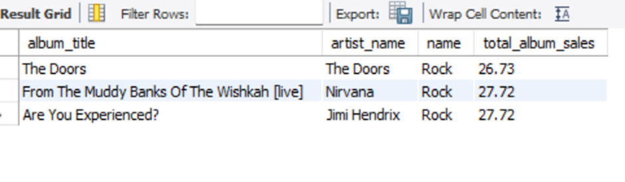
Analyzing Top-Selling Albums for Promotional Focus
Rock Dominates: The top-selling albums belong to the Rock genre, indicating strong demand and potential for success.
Iconic Artists: The featured artists, Nirvana, Jimi Hendrix, and The Doors, have established fan bases and global recognition.
Cross-Promotion Opportunities: Bundling or cross-promoting related Rock albums can increase sales and encourage exploration of the genre.

Slide 13
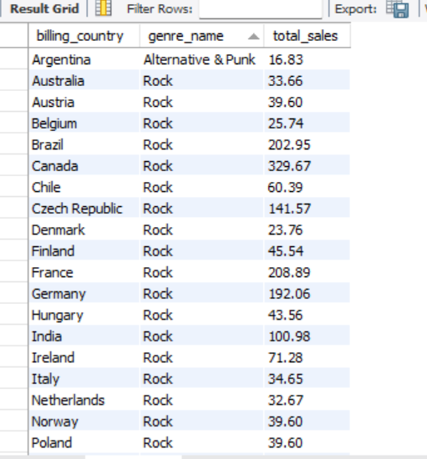
Top-Selling Genres in Different Countries
Global Appeal of Rock: Rock's versatility and enduring popularity make it a safe bet for new record labels targeting diverse markets.
Regional Variations: While Rock is a global trend, specific countries exhibit unique preferences within the genre.
Subgenre Opportunities: Exploring subgenres like Alternative & Punk can expand the reach of Rock music and appeal to niche audiences.

Slide 14
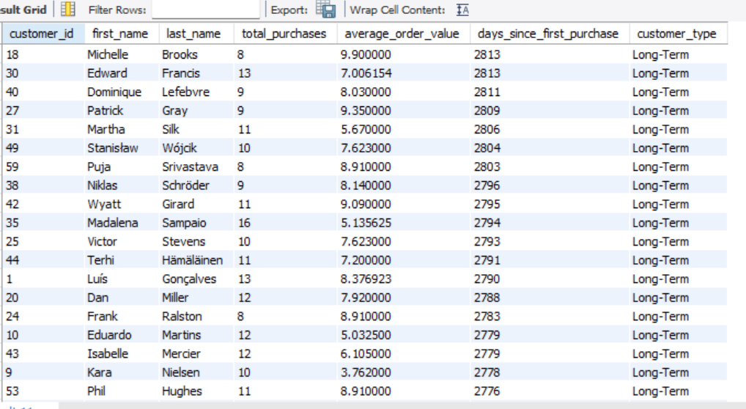
Customer Segmentation:
Segmenting customers based on tenure and spending patterns provides valuable insights into their needs and behaviors.
Tailoring marketing and loyalty programs to specific customer segments can improve customer retention and increase revenue.
Prioritizing customer engagement, especially for long-term customers, is crucial for building loyalty and encouraging repeat purchases.
Ensure that your products and services align with the needs and preferences of different customer segments to drive customer satisfaction and loyalty.

Slide 15
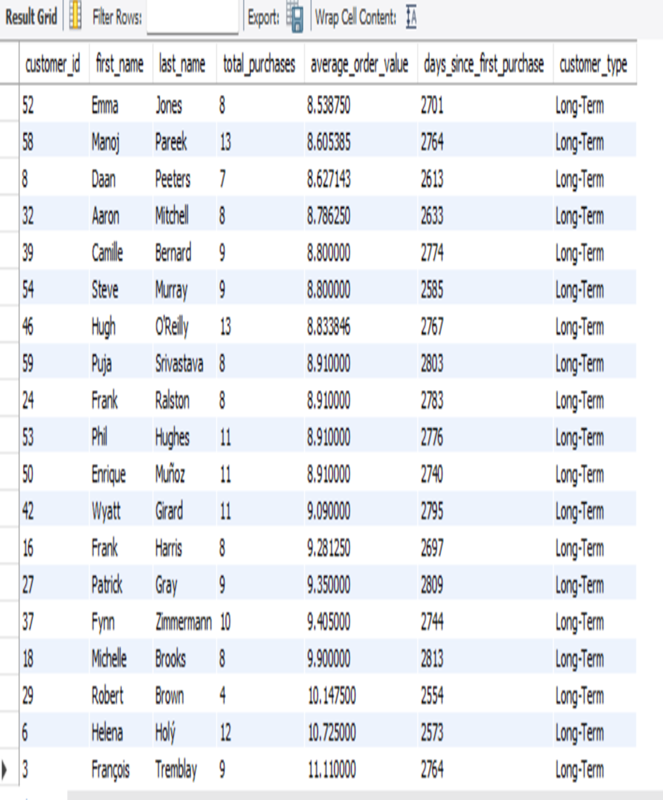
Product Affinity Analysis
Core Customer Segment: A group of long-term customers consistently demonstrate high average order values, indicating strong loyalty and a propensity for premium purchases.
Targeted Marketing: Implement loyalty programs or premium offerings specifically designed for this segment to further enhance engagement and increase average order values.
Exclusive Benefits: Consider providing exclusive products, early access to new releases, or discounts on bulk purchases to reinforce their loyalty and encourage repeat purchases.

Slide 16
Regional Market Analysis & Genre Cross-Promotion Strategy
Analysis shows that Rock and Metal genres dominate the music preferences in most regions, particularly in the USA and Europe. In contrast, regions like Latin America and India are showing growing interest in Latin, Reggae, and Alternative genres.
Regions with lower economic activity or less diversity in musical preferences (e.g., some parts of Europe and North America) exhibit higher churn rates, particularly for genres outside of Rock and Metal.
Smaller segments are emerging, such as those interested in Latin and Reggae, and Alternative & Punk with Hip Hop/Rap. Chinook should focus on niche marketing campaigns to capture these loyal customers and increase retention.

Slide 17

The high-spending, inactive customers present significant opportunities for re-engagement with personalized incentives such as discounts or exclusive offers.
Targeted retention strategies, such as loyalty programs, personalized recommendations, and time-sensitive promotions, should be prioritized in these markets.
Analyze behavioral patterns of at-risk segments in Canada and France to create tailored marketing strategies.

Slide 18
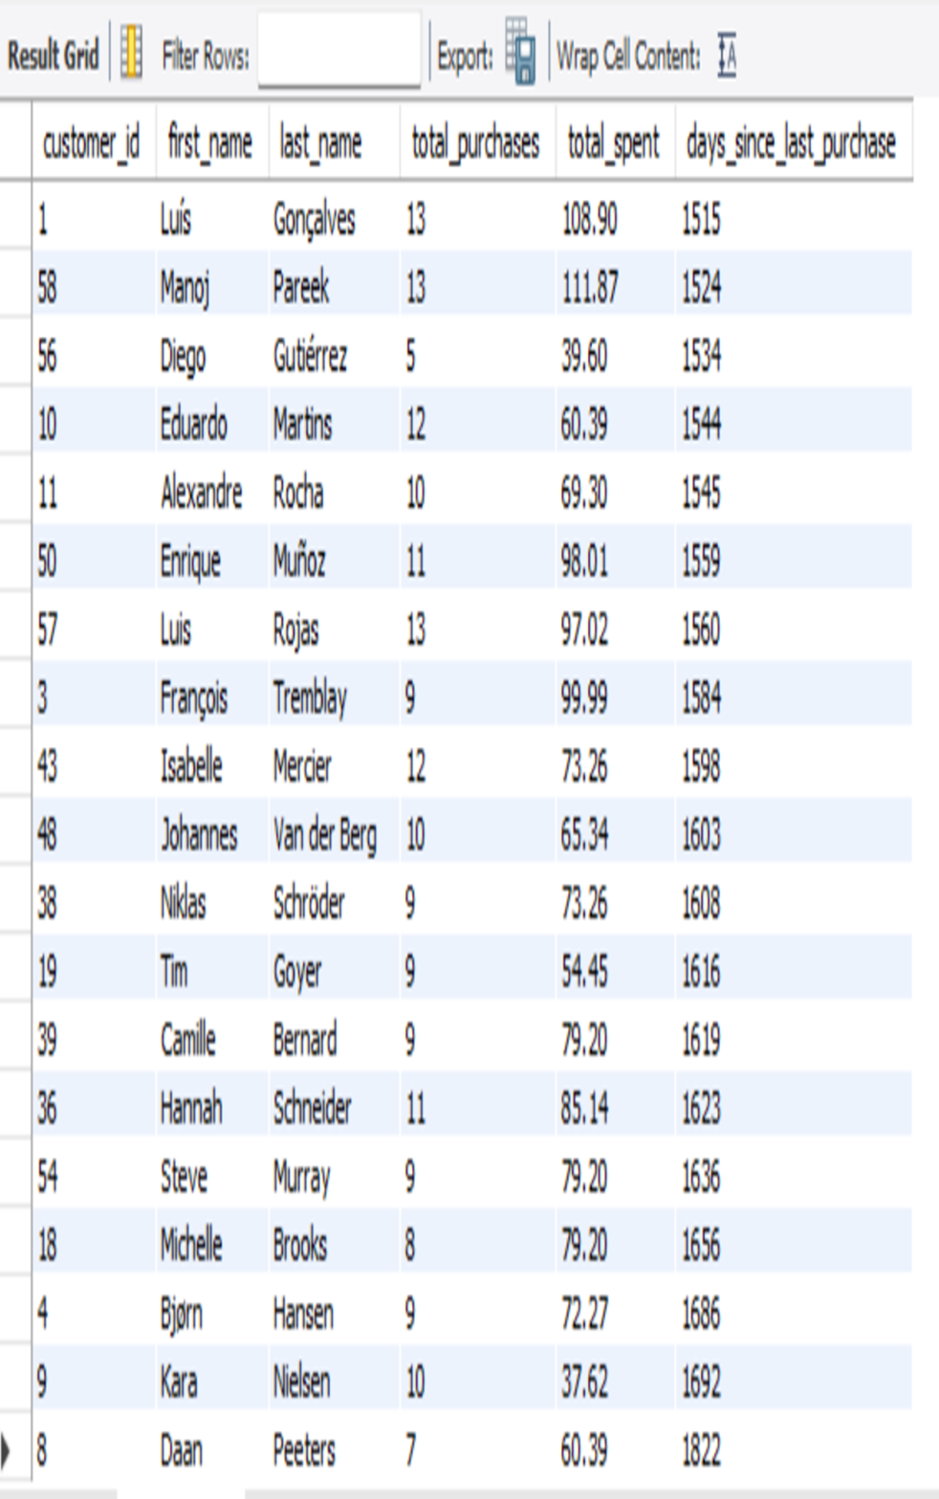
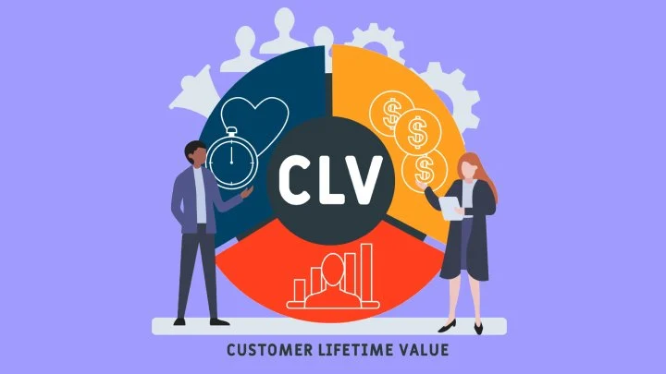
Customer Lifetime Value (CLV) Analysis
By analyzing customer tenure, purchase history, and engagement patterns, we can identify key segments for re-engagement, loyalty programs, and proactive retention efforts.
Customers like Manoj Pareek, Luís Gonçalves, and Hugh O'Reilly have made 13+ purchases and spent over $100 but have been inactive for over 1500 days.
Customers like João Fernandes and Patrick Gray (9-10 purchases, ~$76-$102) show signs of declining engagement.
Proactively monitor medium-spending customers showing declining engagement. Offer timely cross-sell or upsell opportunities to keep them engaged.

Slide 19
Promotional Campaigns on Customer Acquisition, Retention, and Sales
Replicate Successful Campaigns: Early 2017 promotions were effective; similar campaigns should be implemented to boost early-year acquisition.
Target High-Value Customers: Focus on personalized promotions and loyalty programs for high-value customers, especially in low-acquisition periods like May 2017.
Reassess Post-June Strategy: Investigate why acquisition dropped after June and experiment with different marketing channels and incentives to increase retention and spending.

Slide 20

Customers have different preferences for music from specific eras, ranging from older classics to newer releases.
By analyzing purchase patterns, we can segment customers based on their music era preferences, enabling targeted marketing.
Develop campaigns to target specific customer segments, such as promoting classic albums to customers who favor older music or bundling classic and modern albums to appeal to a broader audience.

Slide 21
STRATEGIC RECOMMENDATION
Customer Segmentation and Targeting
Customer Segmentation: Segment customers based on their spending patterns, purchase frequency, and loyalty to identify distinct groups.
Targeted Marketing: Develop tailored marketing strategies for each segment to maximize customer engagement and conversion.
Personalized Offers: Use customer data to deliver personalized offers and recommendations that resonate with their preferences.

Slide 22
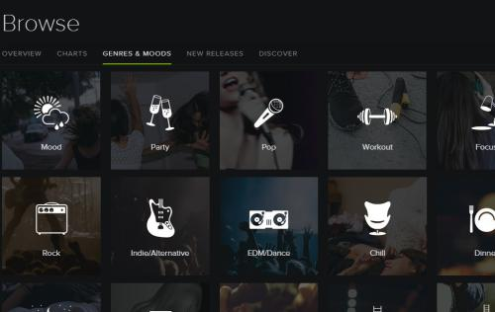
Enhancing Customer Lifetime Value
Loyalty Programs: Implement loyalty programs to reward repeat customers and encourage continued engagement.
Customer Retention Strategies: Focus on improving customer satisfaction and addressing pain points to reduce churn.
Upselling and Cross-Selling: Identify opportunities to upsell or cross-sell products based on customer purchase history and preferences.

Slide 23
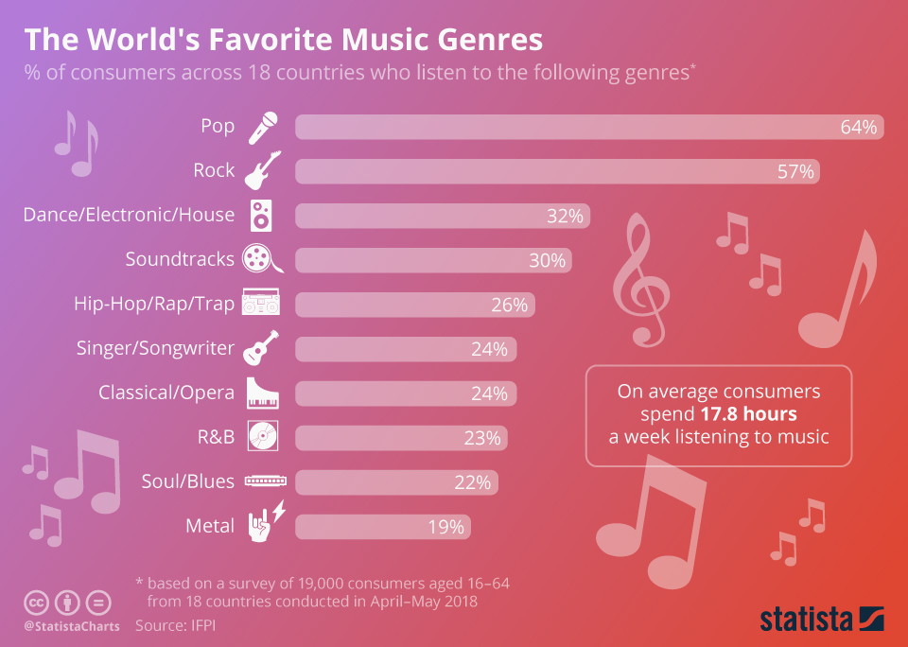
Leveraging Product Affinity
Product Recommendations: Utilize product affinity analysis to recommend complementary products and increase average order values.
Product Bundling: Create product bundles based on frequently purchased items to encourage customers to buy more.
Personalized Shopping Experiences: Provide personalized product recommendations on the website or in email campaigns to enhance customer engagement.

Slide 24
CONCLUSION
The customer base exhibits diverse spending patterns, indicating the need for targeted marketing strategies. A significant number of customers have remained loyal over time, highlighting the importance of retention efforts. Analyzing product affinity can inform cross-selling and upselling initiatives.
Implement targeted marketing strategies based on customer segments, focusing on their specific needs and preferences. Prioritize customer retention by offering loyalty programs, personalized recommendations, and exceptional customer service.
Incorporate demographic data to further refine customer segmentation. Assess the competitive landscape to identify opportunities and challenges.

Slide 25
THANK YOU !

